Slide 1
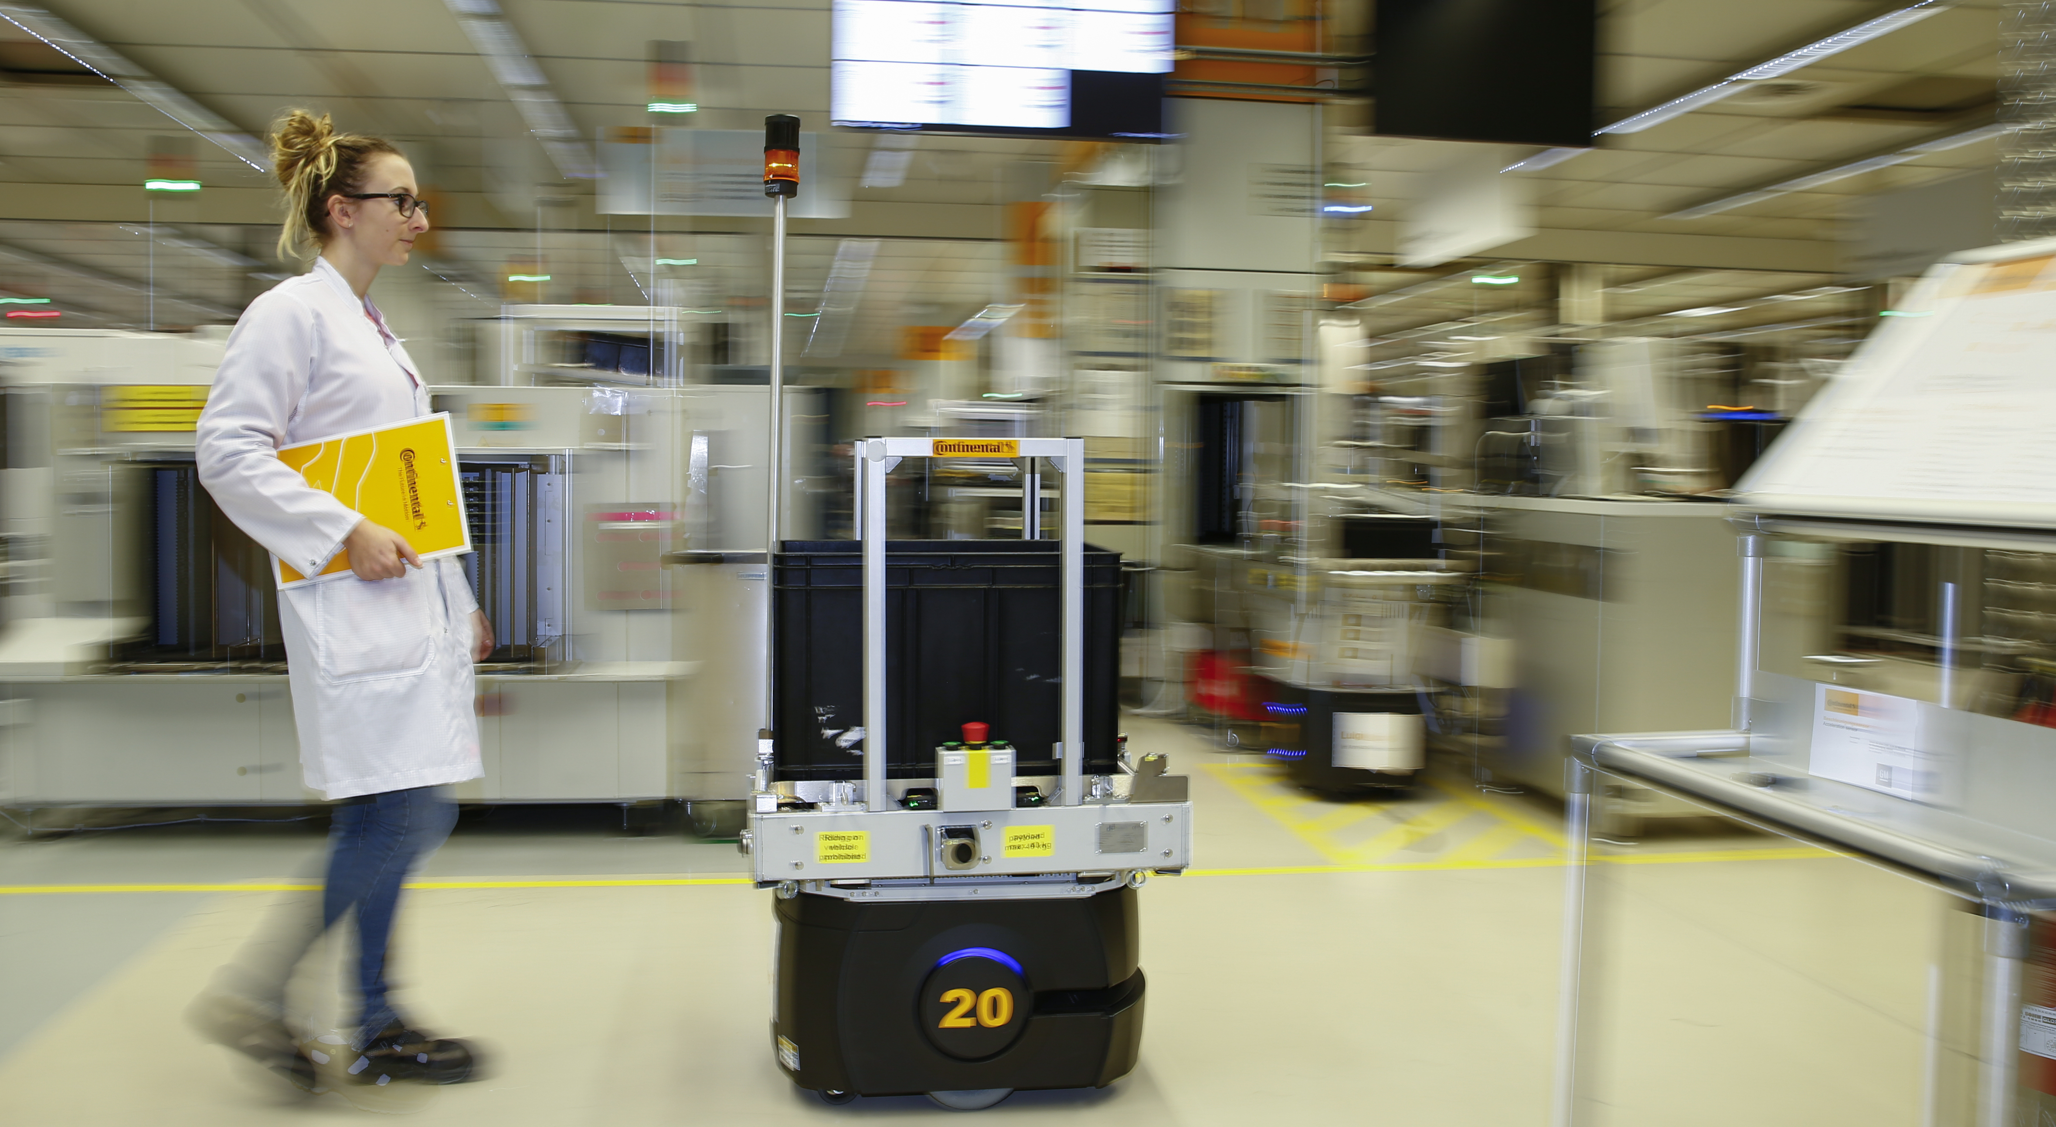

# Hackaburg Challenge
# Task:
> Develop an AI/LLM solution that interprets and explains error codes from our automated guided vehicles (AGVs)
# Resources:
> Real-world AGV data
> Comprehensive user manual

